Slide 1
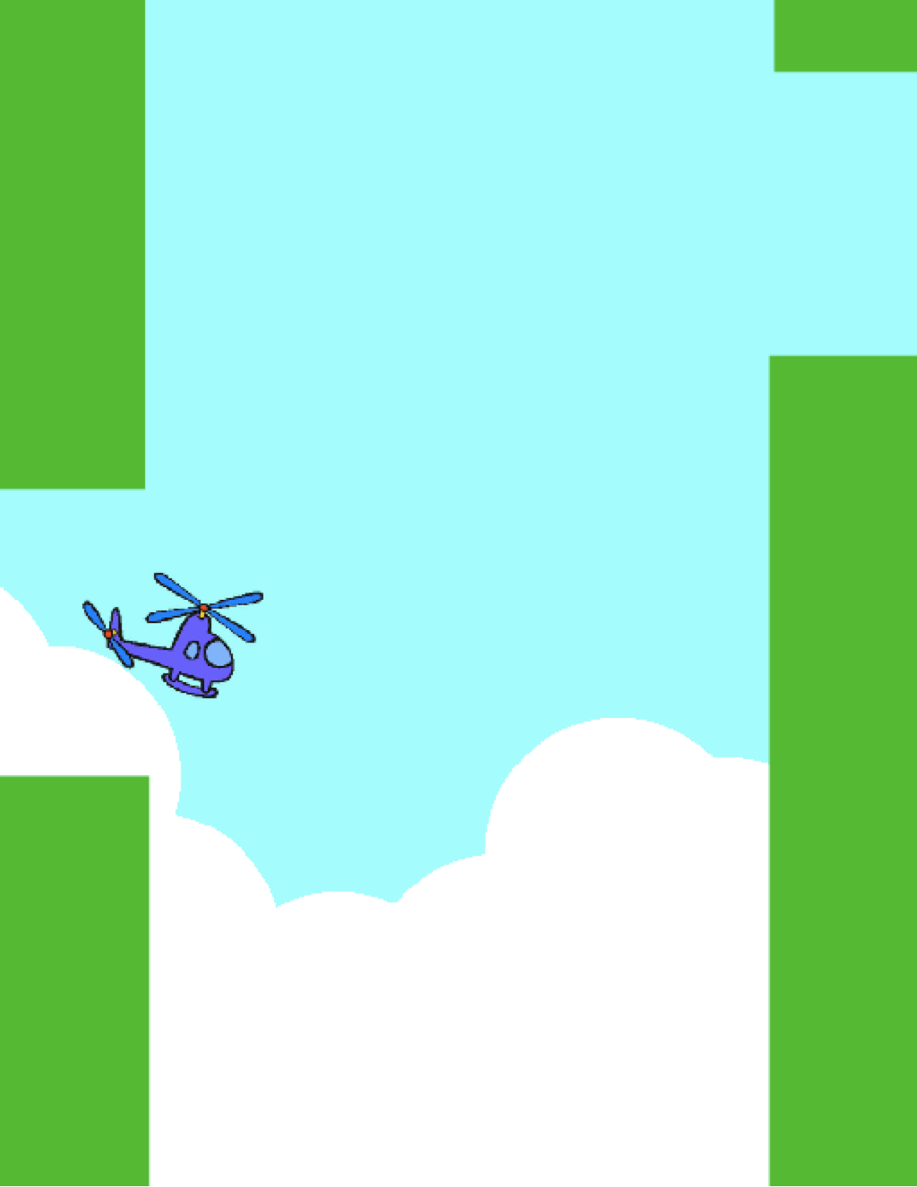
UNIT 4
GAMES
WHAT’S INCLUDED
YOU ARE HERE
DREAM GAME LIST 74
STARTER GAMES 76
SCORE 80
EXTENSIONS 82
INTERACTIONS 84
DEBUG IT! 86
0
1
2
3
4
5
6
71
Notes:
<numéro>

Slide 2
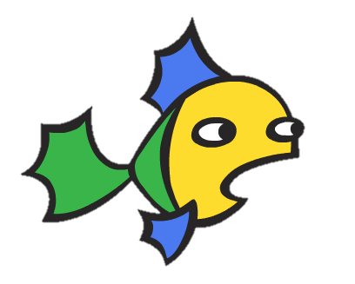
UNIT 4
OVERVIEW
THE “BIG IDEA”
THE “BIG IDEA”
Personalization is an important guiding principle in the design of the creative computing experience. By “personalization”, we mean both connecting to personal interests and acknowledging that personal interests can vary considerably. There are many ways of knowing and doing – and exploring these multiple ways can help support interest, motivation, and persistence among young learners. In this unit, learners explore some of the advanced concepts and challenging problems associated with game design. An advanced concept or challenging problem can be made more accessible if rooted in activities that are personally meaningful. As an example of the power of context, we turn to a story shared by Mitch Resnick – the director of the Scratch project at MIT.
A few years ago I was at one of our Computer Clubhouse after school centers and I saw a 13-year-old boy working on creating his own game. He was able to control a character, in this case, a fish. He wanted the game to keep track of the score, so you could see how many little fish had been eaten by the big fish, but he didn’t know how.
I saw this as an opportunity to introduce the idea of variables. I showed this to him and he immediately saw how he could use this block to keep track of how many fish had been eaten in his game. He took the block and put it in the script right where the big fish eats the little fish. He quickly tried it. Sure enough, every time the big fish ate a little fish, the score goes up by 1.
I think that he really got a deep understanding of variables because he really wanted to make use of it. That's one of our overall goals of Scratch. It's not just about variables, but for all types of concepts. We see that kids get a much deeper understanding of the concepts they learn when they are making use of the concepts in a meaningful and motivating way.
KEY WORDS, CONCEPTS, & PRACTICES
abstracting and modularizing
conditionals
operators
data
variables and lists
sensing
feedback fair
arcade day
puzzle jar
brain dump
LEARNING OBJECTIVES
Students will:
be introduced to the computational concepts of conditionals, operators, and data (variables and lists)
become more familiar with the computational practices of experimenting and iterating, testing and debugging, reusing and remixing, and abstracting and modularizing by building and extending a self-directed maze, pong, or scrolling game project
identify and understand common game mechanics
NOTES
Many new concepts are explored in this unit, so we’ve included added support in the form of example project studios, new programming puzzles for extra practice, and starter game projects that we encourage you to remix and reuse as needed.
72
Notes:
<numéro>

Slide 3

CHOOSE YOUR OWN ADVENTURE
In this unit, learners will become game designers and experience creating their own game project. Guided by the activities in this unit, students will be introduced to game mechanics and game development while building understandings of computational concepts (conditionals, operators, data) and computational practices (abstracting and modularizing).
You could get students started on their game projects with the Starter Games activity and then support further development through other activities. From learning common game mechanics such as keeping score and side-scrolling, to the creation of multiplayer games (e.g., Pong), Unit 4 activities offer students multiple opportunities to practice game development.
POSSIBLE PATH
SESSION 1
SESSIONS 1 - 5
SESSION 2
SESSION 3
SESSION 4
SESSION 5
DREAM GAME LIST
STARTER
GAMES
SCORE
EXTENSIONS
INTERACTIONS
DEBUG IT!
What do all games
have in common?
How can you use Scratch to build an interactive game?
How can you add score to a game using variables?
What are different ways of extending and increasing difficulty in a game?
Tackle nine
Scratch
programming puzzles.
Help!
Can you debug these five Scratch programs?
73

Slide 4


DREAM GAME LIST
OBJECTIVES
By completing this activity, students will:
identify common design elements of games
UNIT 4 ACTIVITY
_{SUGGESTED TIME}
15–30 MINUTES
ACTIVITY DESCRIPTION
RESOURCES
Divide students into small groups of 2-3 people.
In their small groups, ask students to generate a list of games that they enjoy playing. They can compose the list using their design journals or a sheet of paper. We suggest facilitating the brain dump brainstorming activity: give students a short time period (1-2 minutes) to write down as many games as they can. Then, have students narrow down their favorites from the brain dump list.
After a few minutes, ask groups about their list of games:
What do the games have in common?
What features of their design make them a game?
Facilitate a class discussion about what characteristics make up a game and generate a class list of common game mechanics. Next, ask students to imagine their dream game and write a list of design elements for that game.
Invite students to share their dream game lists in their small groups or critique groups (see Unit 0 Critique Group activity) to get feedback and suggestions.
paper to write down game design elements (optional)
things to sketch with (pencils, pens, markers, etc.)
REFLECTION PROMPTS
Make a list of your favorite games.
What do the games have in common?
What features of their design make them a game?
Create a list of design elements for your dream game.
REVIEWING STUDENT WORK
Do the dream game lists include features of games?
What design elements are similar or different from the class group list?
What do the lists tell you about the kinds of games and the types of play your students enjoy?
NOTES
NOTES TO SELF
Invite students to refer back to this dream game list while programming games in other Unit 4 activities.
74
Notes:
<numéro>

Slide 5
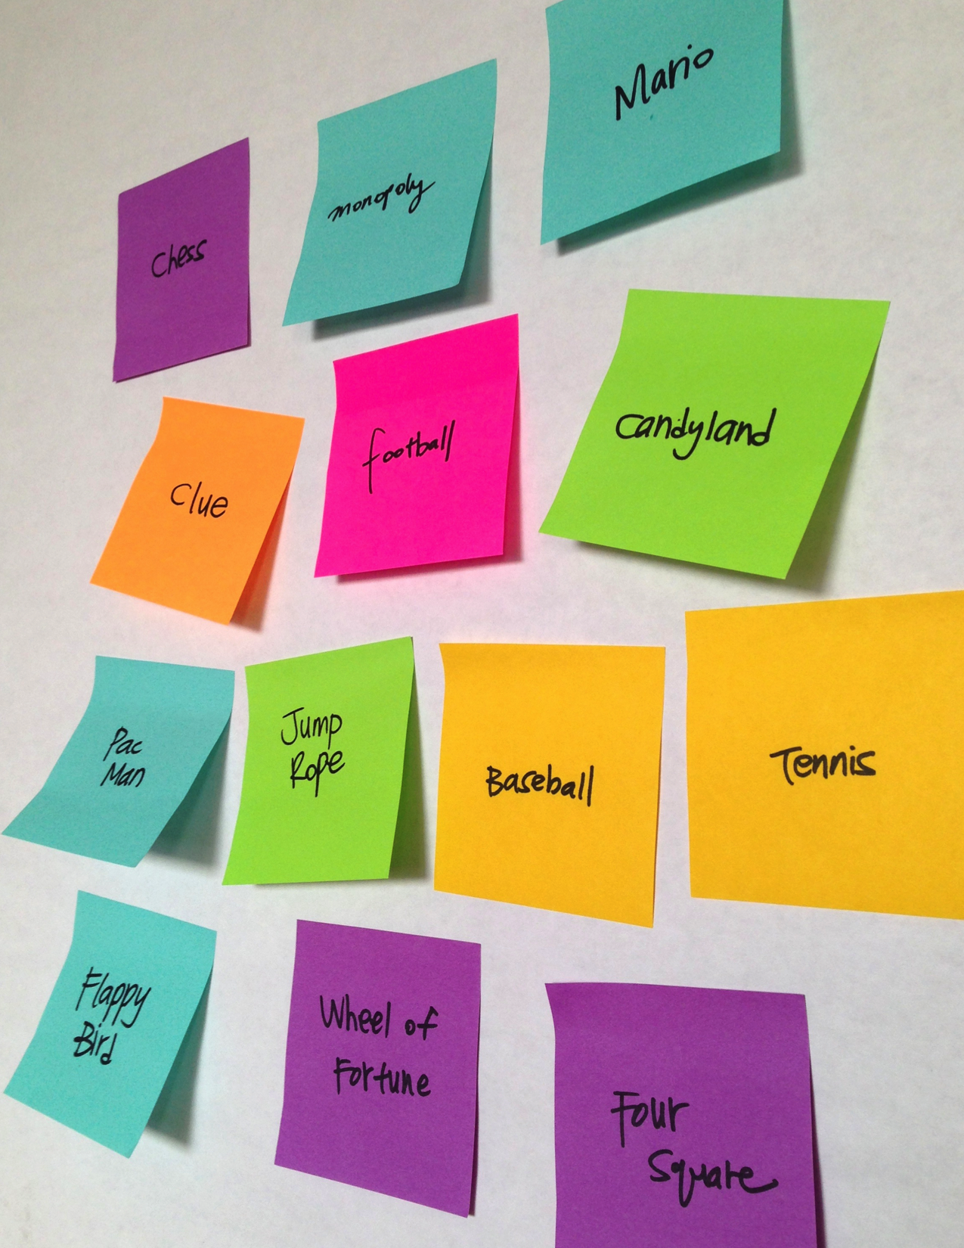
Notes:
<numéro>

Slide 6

STARTER GAMES
OBJECTIVES
By completing this activity, students will:
develop greater fluency with computational concepts (conditionals, operators, data) and practices (experimenting and iterating, testing and debugging, reusing and remixing, abstracting and modularizing) by working on a self-directed game project
UNIT 4 ACTIVITY
_{SUGGESTED TIME}
45–60 MINUTES
ACTIVITY DESCRIPTION
RESOURCES
In this activity, students will create a starter game project that can be revisited and extended during the Score, Extensions, and Interactions activities. Optionally, show the Maze, Pong, and Scrolling example starter projects, and have the Maze, Pong, and Scrolling handouts available to guide students.
Choose one game project to facilitate as a class or let students choose which game they want to create: maze, pong, or scrolling. Give students time to start building their games or let them remix one of the starter projects.
Encourage students to get feedback on their games-in-progress. We suggest the feedback fair activity: half of the students stay in their seats with their projects open while the other half walks around exploring projects, asking questions, and giving feedback, then switch sides. Optionally, have students add their final game projects to the Games studio or a class studio.
Ask students to respond to the reflection prompts in their design journals or in a group discussion.
Maze handout
Maze example starter project
http://scratch.mit.edu/projects/11414041
Pong handout
Pong example starter project
http://scratch.mit.edu/projects/10128515
Scrolling handout
Scrolling example starter project
http://scratch.mit.edu/projects/22162012
Games studio
http://scratch.mit.edu/studios/487504
REFLECTION PROMPTS
What was challenging about designing your game?
What are you proud of?
REVIEWING STUDENT WORK
Do games include conditionals, operators, and data?
NOTES
NOTES TO SELF
To celebrate and share final game creations, we recommend hosting an Arcade Day. Final game projects are placed in presentation mode; students walk around and play each other’s games.
The Scrolling game option introduces cloning. Help students learn more about the cloning blocks with the Cloning handout from Unit 5 Advanced Features.
76
Notes:
<numéro>

Slide 7
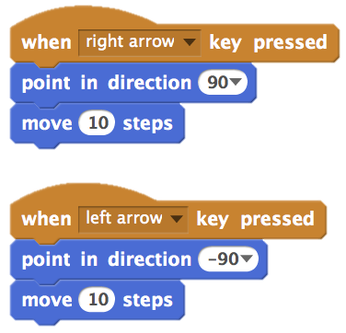
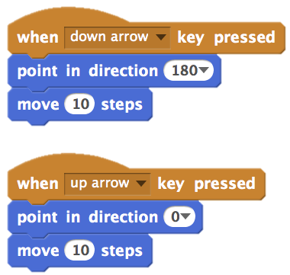
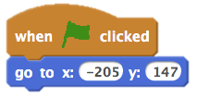
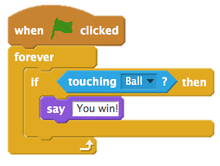
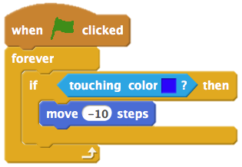
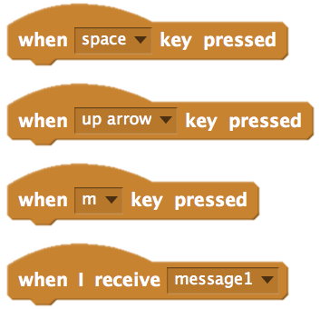
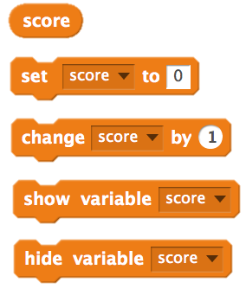
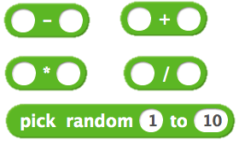
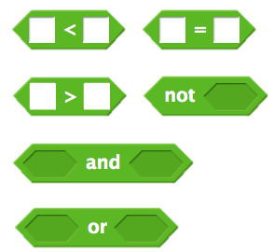
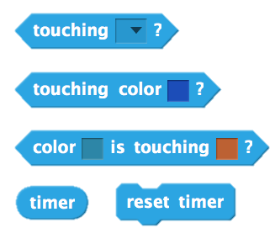
MAZE
HOW CAN YOU USE SCRATCH TO BUILD AN INTERACTIVE GAME?
In this project, you will create a game. This game includes interactions between sprites, score, and levels. You move a sprite from the start of a maze to the end without touching the walls.
START HERE
Draw a maze-like background and use different colors for the walls and end-of-maze marker.
Add a sprite.
Make your game interactive!
These scripts give the player control over sprite movement in the maze.
THINGS TO TRY
This tells your sprite where to begin and marks the start of the maze.
Add multiple levels to your game! This can be done through the use of different backdrops and using braodcast blocks to trigger the next level.
Use the make a variable block to keep score!
Experiment with timer blocks to add new challenges to your maze!
This tells the end-of-maze sprite that players win when the ball touches this sprite.
This will cause your sprite to bounce off the blue walls of the maze.
FINISHED?
BLOCKS TO PLAY WITH
FINISHED?
FINISHED?
Add your project to the Games Studio: http://scratch.mit.edu/studios/487504
Swap games with a partner and walk each other through your creations.
Notes:
<numéro>

Slide 8
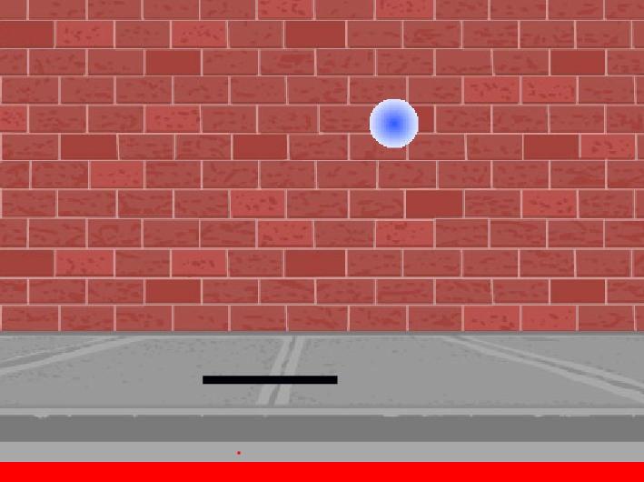
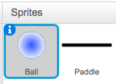
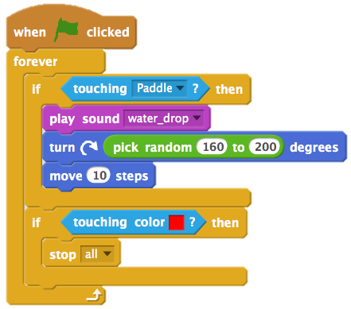
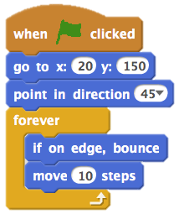
PONG
HOW CAN YOU USE SCRATCH TO BUILD AN INTERACTIVE GAME?
In this project, you will create a game. This game includes interactions between sprites, score, and levels. The game is similar to the classic game of pong, where the goal is to keep the sprite from getting past you.
START HERE
Create two sprites: a paddle for the user to control and a ball the user will be playing with.
Make your paddle sprite interactive.
Bring your game to life!
THINGS TO TRY
How do you add difficulty to your game? Creating different levels, using a timer, or keeping score are a few examples of things you could do.
Experiment with changing the look of your game by editing the backdrops!
Explore using different key presses to control your sprites!
Interacts with the walls
Interacts with the paddle
These control the ball - if touching the paddle or a wall, it continues moving. If touching red (meaning the ball moved past the paddle) the game ends.
FINISHED?
BLOCKS TO PLAY WITH
FINISHED?
FINISHED?
Add your project to the Games Studio: http://scratch.mit.edu/studios/487504
Swap games with a partner and walk each other through your creations.
Notes:
<numéro>

Slide 9
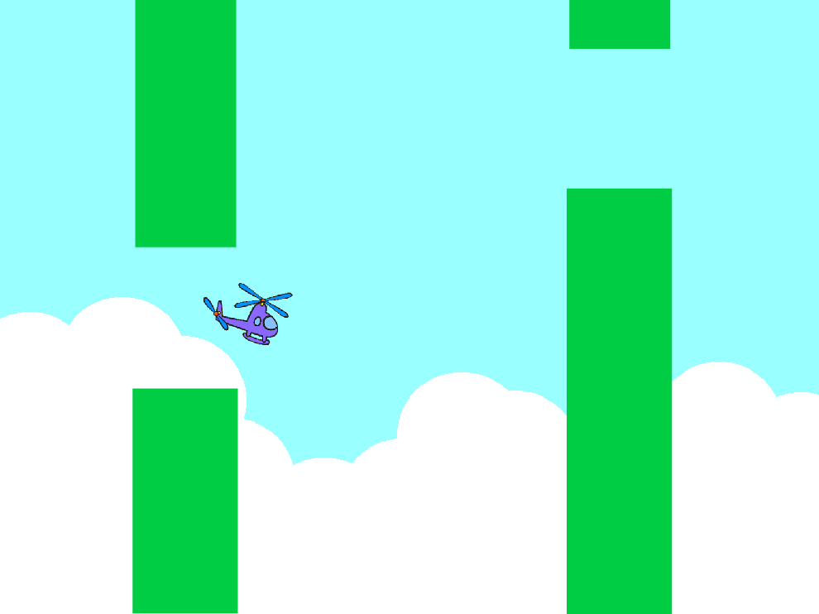
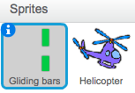
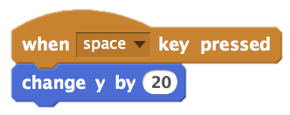
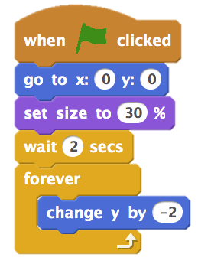
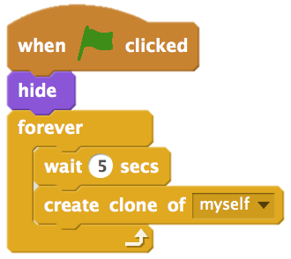
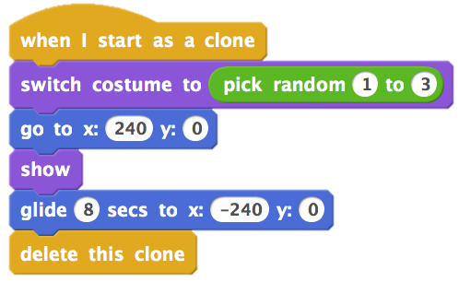
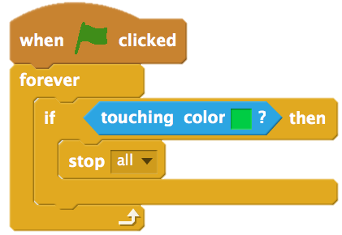
SCROLLING
HOW CAN YOU USE SCRATCH TO BUILD AN INTERACTIVE GAME?
In this project, you will create a game. This game includes interactions between sprites, score, and levels. The game is similar to Flappy Bird, where the goal is to keep an object from falling to the ground or touching certain objects.
START HERE
Create two sprites: one for the player to control (helicopter) and one to avoid (gliding bars).
Make the helicopter interactive.
Bring your game to life by adding scripts to make the gliding bars scroll across the stage!
Controls sprite movement
THINGS TO TRY
How do you add difficulty to your game? Creating different levels, using a timer, or keeping score are a few examples of things you could do.
Experiment with changing the look of your game by editing the backdrops!
Explore using different key presses to control your sprites!
This creates clones, which are used in the script below to make the bars scroll across the screen:
Causes sprite to constantly fall downward
Specifies when the game ends
FINISHED?
BLOCKS TO PLAY WITH
FINISHED?
FINISHED?
Add your project to the Games Studio: http://scratch.mit.edu/studios/487504
Swap games with a partner and walk each other through your creations.
Notes:
<numéro>

Slide 10

SCORE
OBJECTIVES
By completing this activity, students will:
be able to describe what a variable is and why variables are useful
be introduced to the computational concept of data
experience remixing and reusing a project or part of a project
UNIT 4 ACTIVITY
_{SUGGESTED TIME}
30–45 MINUTES
ACTIVITY DESCRIPTION
RESOURCES
Optionally, explore the Fish Chomp starter project as a group and have the Score handout available to guide students.
Help students open the Fish Chomp starter project. Give students time to explore variables by remixing the Fish Chomp Starter Project to add score to the game. Optionally, give students time to incorporate score into their previously started maze, pong, or scrolling game projects.
Allow students to share their Fish Chomp remixes or game projects with added score. We suggest the Design Demo activity: invite a few students to present their projects to the group and demonstrate how they implemented score using variables. Optionally, have students add their remixes to the Fish Chomp Remix studio or a class studio.
Ask students to think back on the design process by responding to the reflection prompts in their design journals or in a group discussion.
Score handout
Score examples studio
http://scratch.mit.edu/studios/218313
Fish Chomp starter project
http://scratch.mit.edu/projects/10859244
Fish Chomp remix studio
http://scratch.mit.edu/studios/475615
REFLECTION PROMPTS
How would you explain variables to someone else?
What are variables good for?
REVIEWING STUDENT WORK
Can students explain what a variable is and what variables are good for?
NOTES
NOTES TO SELF
Encourage students to clarify their understanding of variables by exploring code from sample projects in the Score examples studio.
Variables are an important mathematical and computational concept. Students are taught about variables in their math and science classes, but many students have a difficult time learning them. Games are one way to make the usefulness of variables more concrete.
80
Notes:
<numéro>

Slide 11
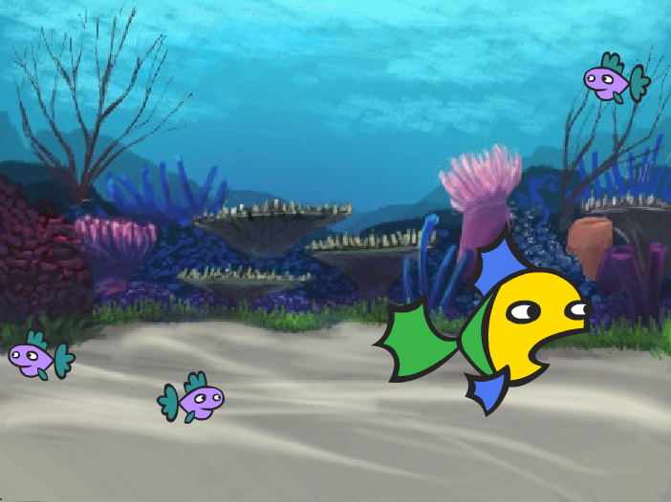
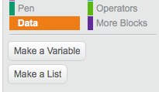
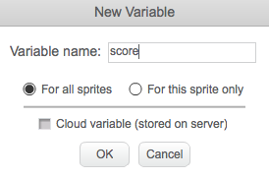
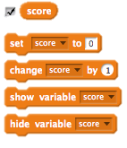
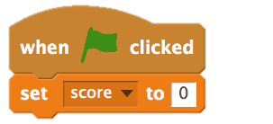
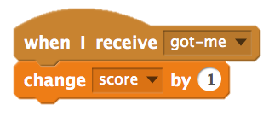
SCORE
HOW CAN YOU KEEP SCORE IN A SCRATCH PROJECT?
Fish Chomp is a game where players try to catch as many fish as they can by guiding a sprite with the mouse. In this activity, you will remix Fish Chomp by adding a score with variables.
START HERE
Go to the Fish Chomp project page:
http://scratch.mit.edu/projects/10859244
Click on the Make a Variable button in the Data category to create and name a variable for score.
Experiment with your new variable blocks to incorporate score into your project!
FEELING STUCK?
_{THAT’S OKAY! TRY THESE THINGS…}
FINISHED?
Not sure how to work with variables? Check out this project for more information: http://scratch.mit.edu/projects/2042755
Or take a look at this video: http://youtu.be/uXq379XkhVw
Explore and study code in games that use score to learn more about creating variables and incorporating score into a project.
Add your project to the Fish Chomp Remix studio: http://scratch.mit.edu/studios/475615
Challenge yourself to do more! How can you use score to add difficulty to your game design?
Find a game you are inspired by and remix it!
Notes:
<numéro>

Slide 12
EXTENSIONS
OBJECTIVES
By completing this activity, students will:
become more familiar with the concepts of conditionals, operators, and data by exploring programs that illustrate common game mechanics
UNIT 4 ACTIVITY
_{SUGGESTED TIME}
30–45 MINUTES
ACTIVITY DESCRIPTION
RESOURCES
Optionally, show example projects from the Extensions studio and have the Extensions handout available to guide students.
Give students time to explore the code of programs in the Extensions studio to investigate different ways games can be increased in difficulty or extended. Ask students to select one or more extensions to add to their previously started maze, pong, or scrolling game projects. Give students time to experiment and incorporate the extension(s) into their games.
Allow students to share their extended game projects with one another. We suggest facilitating the pair-share or design demo activity to let students share their games and demonstrate what they learned.
Ask students to think back on the design process by responding to the reflection prompts in their design journals or in a group discussion.
Extensions handout
Extensions studio
http://scratch.mit.edu/studios/475619
REFLECTION PROMPTS
What are different ways of increasing difficulty in a game?
Which extensions did you add to your game project?
Describe your process for including the extension(s) in your game?
REVIEWING STUDENT WORK
Were students able to incorporate extensions into their original game projects?
NOTES
NOTES TO SELF
To provide more scaffolding for students needing extra support, we suggest walking through one extension sample program (e.g., levels) as a class and helping students add the extension to their game projects.
The backpack tool is one way students can incorporate parts of the extension projects into their starter games. Learn more about backpack at http://bit.ly/scratchbackpack
82
Notes:
<numéro>

Slide 13
EXTENSIONS
+ SCORE http://scratch.mit.edu/projects/1940443
Demonstrates how to set and change a score. Receive 10 points every
time the Scratch cat is clicked.
HOW CAN YOU EXTEND AND REIMAGINE GAMES IN SCRATCH?
+ LEVELS http://scratch.mit.edu/projects/1940453
Demonstrates how to change levels. Score increases by 1 every time the
space bar is pressed. Level increases by 1 for every 10 points.
Get into game design by adding extended features within your Scratch project! Choose at least one (or more!) of the following extensions and add it to your previously started maze, pong, or scrolling games.
+ TIMER http://scratch.mit.edu/projects/1940445
Demonstrates how to use a timer. Use the mouse to navigate the Scratch
cat to Gobo.
+ ENEMIES http://scratch.mit.edu/projects/1940450
Demonstrates how to add an enemy. Avoid the tennis ball by using the
up and down arrow keys.
+ REWARDS http://scratch.mit.edu/projects/1940456
Demonstrates how to collect items. Use the arrow keys to move the
Scratch cat around to collect quest items.
START HERE
Go to the Extensions studio:
http://scratch.mit.edu/studios/475619
Choose one (or more) of the extensions to explore.
Incorporate your choice into your previously started game projects!
+ MOUSE http://scratch.mit.edu/projects/25192659
Demonstrates how to program the mouse to control game play. Move the
mouse to move the paddle.
+ RESTART http://scratch.mit.edu/projects/25192935
Demonstrates how to make a button to restart the game. Click on the
RESTART button to restart.
+ MENU http://scratch.mit.edu/projects/25192991
Demonstrates how to display a menu screen at the beginning of the
game. Click START or DIRECTIONS on the menu screen.
+ MULTIPLAYER http://scratch.mit.edu/projects/25192711
Demonstrates how to add another player to the game. Player 1 uses the
arrow keys to navigate Pico through the maze, and player 2 uses the
W, A, S, D keys to navigate Nano through the maze.
THINGS TO TRY
FINISHED?
The backpack can be an extremely useful tool while programming in Scratch. It can store everything from lines of code, to music files, to sprites, and more. Try using it to incorporate extensions into your game projects.
Alternatively, sketching out ideas and bits of code in your design journal is another great method for planning how to incorporate your extensions.
Add another extension to your maze, pong, or scrolling game.
Challenge yourself to do more! Continue going through each of the extensions and add them to your games.
Help a neighbor!
Share your project with a neighbor and give each other feedback on your games.
Notes:
<numéro>

Slide 14
INTERACTIONS
OBJECTIVES
By completing this activity, students will:
explore different approaches to making projects interactive by solving a series of nine programming puzzles
gain more fluency in the concepts of conditionals, operators, and data, and the practice of testing and debugging
UNIT 4 ACTIVITY
_{SUGGESTED TIME}
30–45 MINUTES
ACTIVITY DESCRIPTION
RESOURCES
On their own or in small groups of 2-3 people, challenge students to further explore Scratch by creating Scratch programs that solve each of the nine Interactions programming puzzles. These Interactions puzzles explore Sensing blocks, engaging some of the more advanced concepts in Scratch related to interactivity. Optionally, have the Interactions handout available to guide students during the activity.
Each puzzle can have several possible solutions. Invite students or groups to share different solutions and strategies. We suggest the Pair-Share or Design Demo activity to allow students to share their work and describe their process. Optionally, have students add their projects to the Interactions studio or a class studio.
Ask students to think back on the challenge by responding to the reflection prompts in their design journals or in a group discussion.
Interactions handout
Interactions studio
http://scratch.mit.edu/studios/487213
REFLECTION PROMPTS
Which puzzles did you work on?
What was your strategy for solving the puzzles?
Which puzzles helped you think about your game project?
REVIEWING STUDENT WORK
Are the puzzles solved?
Did students explore other approaches for solving the puzzles?
Are there certain blocks or concepts students are still struggling with? How might you help?
NOTES
NOTES TO SELF
Choose particular challenges that highlight new blocks or concepts that you would like students to explore. Or let students invent their own interaction puzzle prompts.
Repurpose these puzzles as an unstructured activity for students who finish other activities early or as a warm-up challenge. Create a puzzle jar: print out, cut, fold, and place copies of each puzzle description in a jar. Then, let students pick puzzles from the jar to solve.
84
Notes:
<numéro>

Slide 15
INTERACTIONS
PUZZLE 1: Whenever you press the B key, the sprite gets a little bigger. Whenever you press the S key, the sprite gets a little smaller.
WHAT DIFFERENTIATES A SCRATCH PROJECT FROM A STILL IMAGE OR A VIDEO?
PUZZLE 2: Whenever the sprite hears a loud sound, it changes color.
Tackle these nine puzzles that engage some of the more advanced concepts in Scratch related to interactivity. Each of these challenges has several possible solutions.
PUZZLE 3: Whenever the sprite is in the top 25% of the screen, it says "I like it up here."
PUZZLE 4: When the sprite touches something blue, it plays a high note. When the sprite touches something red, it plays a low note.
START HERE
PUZZLE 5: Whenever two sprites collide, one of them says: "Excuse me.”
Create a Scratch program for each of the nine interactivity puzzles.
PUZZLE 6: Whenever the cat sprite gets near the dog sprite, the dog turns and runs from the cat.
PUZZLE 7: Whenever you click on the background, a flower appears at that spot.
FEELING STUCK?
_{THAT’S OKAY! TRY THESE THINGS…}
PUZZLE 8: Whenever you click on a sprite, all other sprites do a dance.
PUZZLE 9: Whenever you move the mouse-pointer, the sprite follows but doesn't touch the mouse-pointer.
FINISHED?
Before getting started in Scratch, write down ideas in your design journal for possible ways of programming each of the interactivity puzzles.
Work with a neighbor. Collaborating with a partner can be a great way to solve problems and gain new perspectives on ways of programming in Scratch!
Add each of the projects you create to the Interaction Studio: http://scratch.mit.edu/studios/487213
Help a neighbor!
Discuss your strategies for approaching each puzzle with a partner. Take notes about the similarities and differences in your methods.
Notes:
<numéro>

Slide 16
DEBUG IT!
OBJECTIVES
By completing this activity, students will:
investigate the problem and find a solution to five debugging challenges
explore a range of concepts (conditionals, operators, and data) through the practices of testing and debugging
UNIT 4 ACTIVITY
_{SUGGESTED TIME}
15–30 MINUTES
ACTIVITY DESCRIPTION
ACTIVITY DESCRIPTION
RESOURCES
Optionally, have the Unit 4 Debug It! handout available to guide students during the activity.
Help students open the Debug It! programs from the Unit 4 Debug It! studio or by following the project links listed on the Unit 4 Debug It! handout. Encourage students to click on the “Look Inside” button to investigate the buggy program, tinker with problematic code, and test possible solutions.
Give students time to test and debug each Debug It! challenge. Optionally, have students use the remix function in Scratch to fix the bugs and save corrected programs.
Ask students to reflect back on their testing and debugging experiences by responding to the reflection prompts in their design journals or in a group discussion.
Create a class list of debugging strategies by collecting students’ problem finding and problem solving approaches.
Unit 4 Debug It! handout
Unit 4 Debug It! studio
http://scratch.mit.edu/studios/475634
REFLECTION PROMPTS
What was the problem?
How did you identify the problem?
How did you fix the problem?
Did others have alternative approaches to fixing the problem?
REVIEWING STUDENT WORK
Were students able to solve all five bugs? If not, how might you clarify the concepts expressed in the unsolved programs?
What different testing and debugging strategies did students employ?
NOTES
NOTES TO SELF
This activity provides an opportunity to check in with students who might need some additional attention or support, particularly around the concepts of conditionals (e.g., if), operators (e.g., arithmetic, logical), and data (e.g., variables, lists).
86
Notes:
<numéro>

Slide 17
DEBUG IT!
DEBUG IT! 4.1 http://scratch.mit.edu/projects/24271192
In this project, the "Inventory" list should be updated every time
Scratch Cat picks up a new item. But Scratch Cat can only pick up the
laptop. How do we fix the program?
HELP! CAN YOU DEBUG THESE FIVE SCRATCH PROGRAMS?
In this activity, you will investigate what is going awry and find a solution for each of the five Debug It! challenges.
DEBUG IT! 4.2 http://scratch.mit.edu/projects/24271303
In this project, Scratch Cat gets 10 points for collecting Yellow Gobos
and loses 10 points for colliding with Pink Gobos. But something isn't
working. How do we fix the program?
DEBUG IT! 4.3 http://scratch.mit.edu/projects/24271446
In this project, Scratch Cat is thinking of a number between 1 and 10.
But something is wrong with the guess checking -- it doesn't work
consistently. How do we fix the program?
START HERE
Go to the Unit 4 Debug It! Studio:
http://scratch.mit.edu/studios/475634/
Test and debug each of the five debugging challenges in the studio.
Write down your solution or remix the buggy program with your solution.
DEBUG IT! 4.4 http://scratch.mit.edu/projects/24271475
In this project, the "# of hits" display should increase by 1 every
time the Scratch Cat is hit by a tennis ball. But the "# of hits"
increases by more than 1 when Scratch Cat is hit. How do we fix the
program?
FEELING STUCK?
_{THAT’S OKAY! TRY THESE THINGS…}
DEBUG IT! 4.5 http://scratch.mit.edu/projects/24271560
In this project, Scratch Cat is navigating a maze to get to the yellow
rectangle. But Scratch Cat can walk through walls. How do we fix the
program?
FINISHED?
Make a list of possible bugs in the program.
Keep track of your work! This can be a useful reminder of what you have already tried and point you toward what to try next.
Share and compare your problem finding and problem solving approaches with a neighbor until you find something that works for you!
Add code commentary by right clicking on blocks in your scripts. This can help others understand different parts of your program!
Discuss your testing and debugging practices with a partner. Make note of the similarities and differences in your strategies.
Help a neighbor!
Notes:
<numéro>

Slide 18
88

